Slide 1

Super Speedy Intro to Machine Learning
QBS Bootcamp 2024

Slide 2


Slide 3
Supervised vs Unsupervised Machine Learning
Supervised: Give the algorithm your outcome of interest and ask it to “learn” a model

Slide 4
Supervised vs Unsupervised Machine Learning
Supervised: Give the algorithm your outcome of interest and ask it to “learn” a model
Unsupervised: The algorithm “learns” patterns in your data and identifies clusters

Slide 5
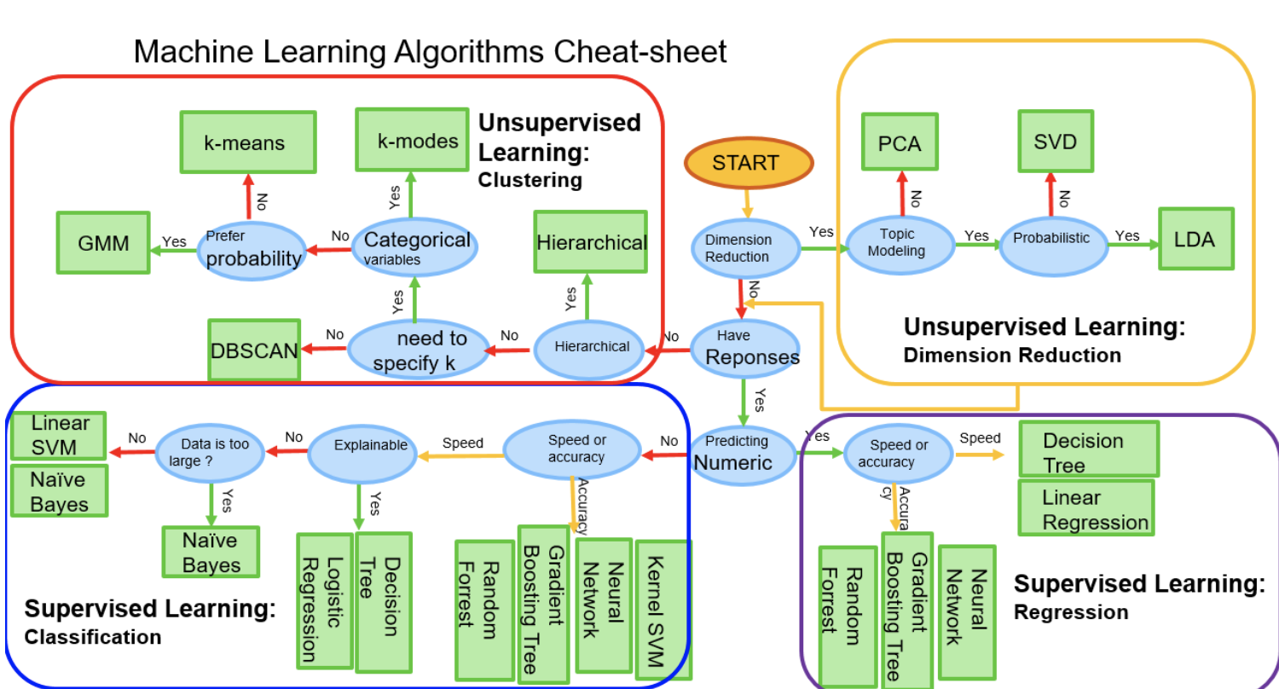

Slide 6
Data Driven Feature Validation
Uses unsupervised learning to see if the selected features naturally cluster the data according to the outcome of interest irrespective of the machine learning model
A good set of predictors should approximately recapitulate the outcome
Check before model building to avoid the garbage-in-garbage-out phenomenon
Additional evidence and adds confidence despite possible overfitting

Slide 7

Unsupervised Methods

Slide 8
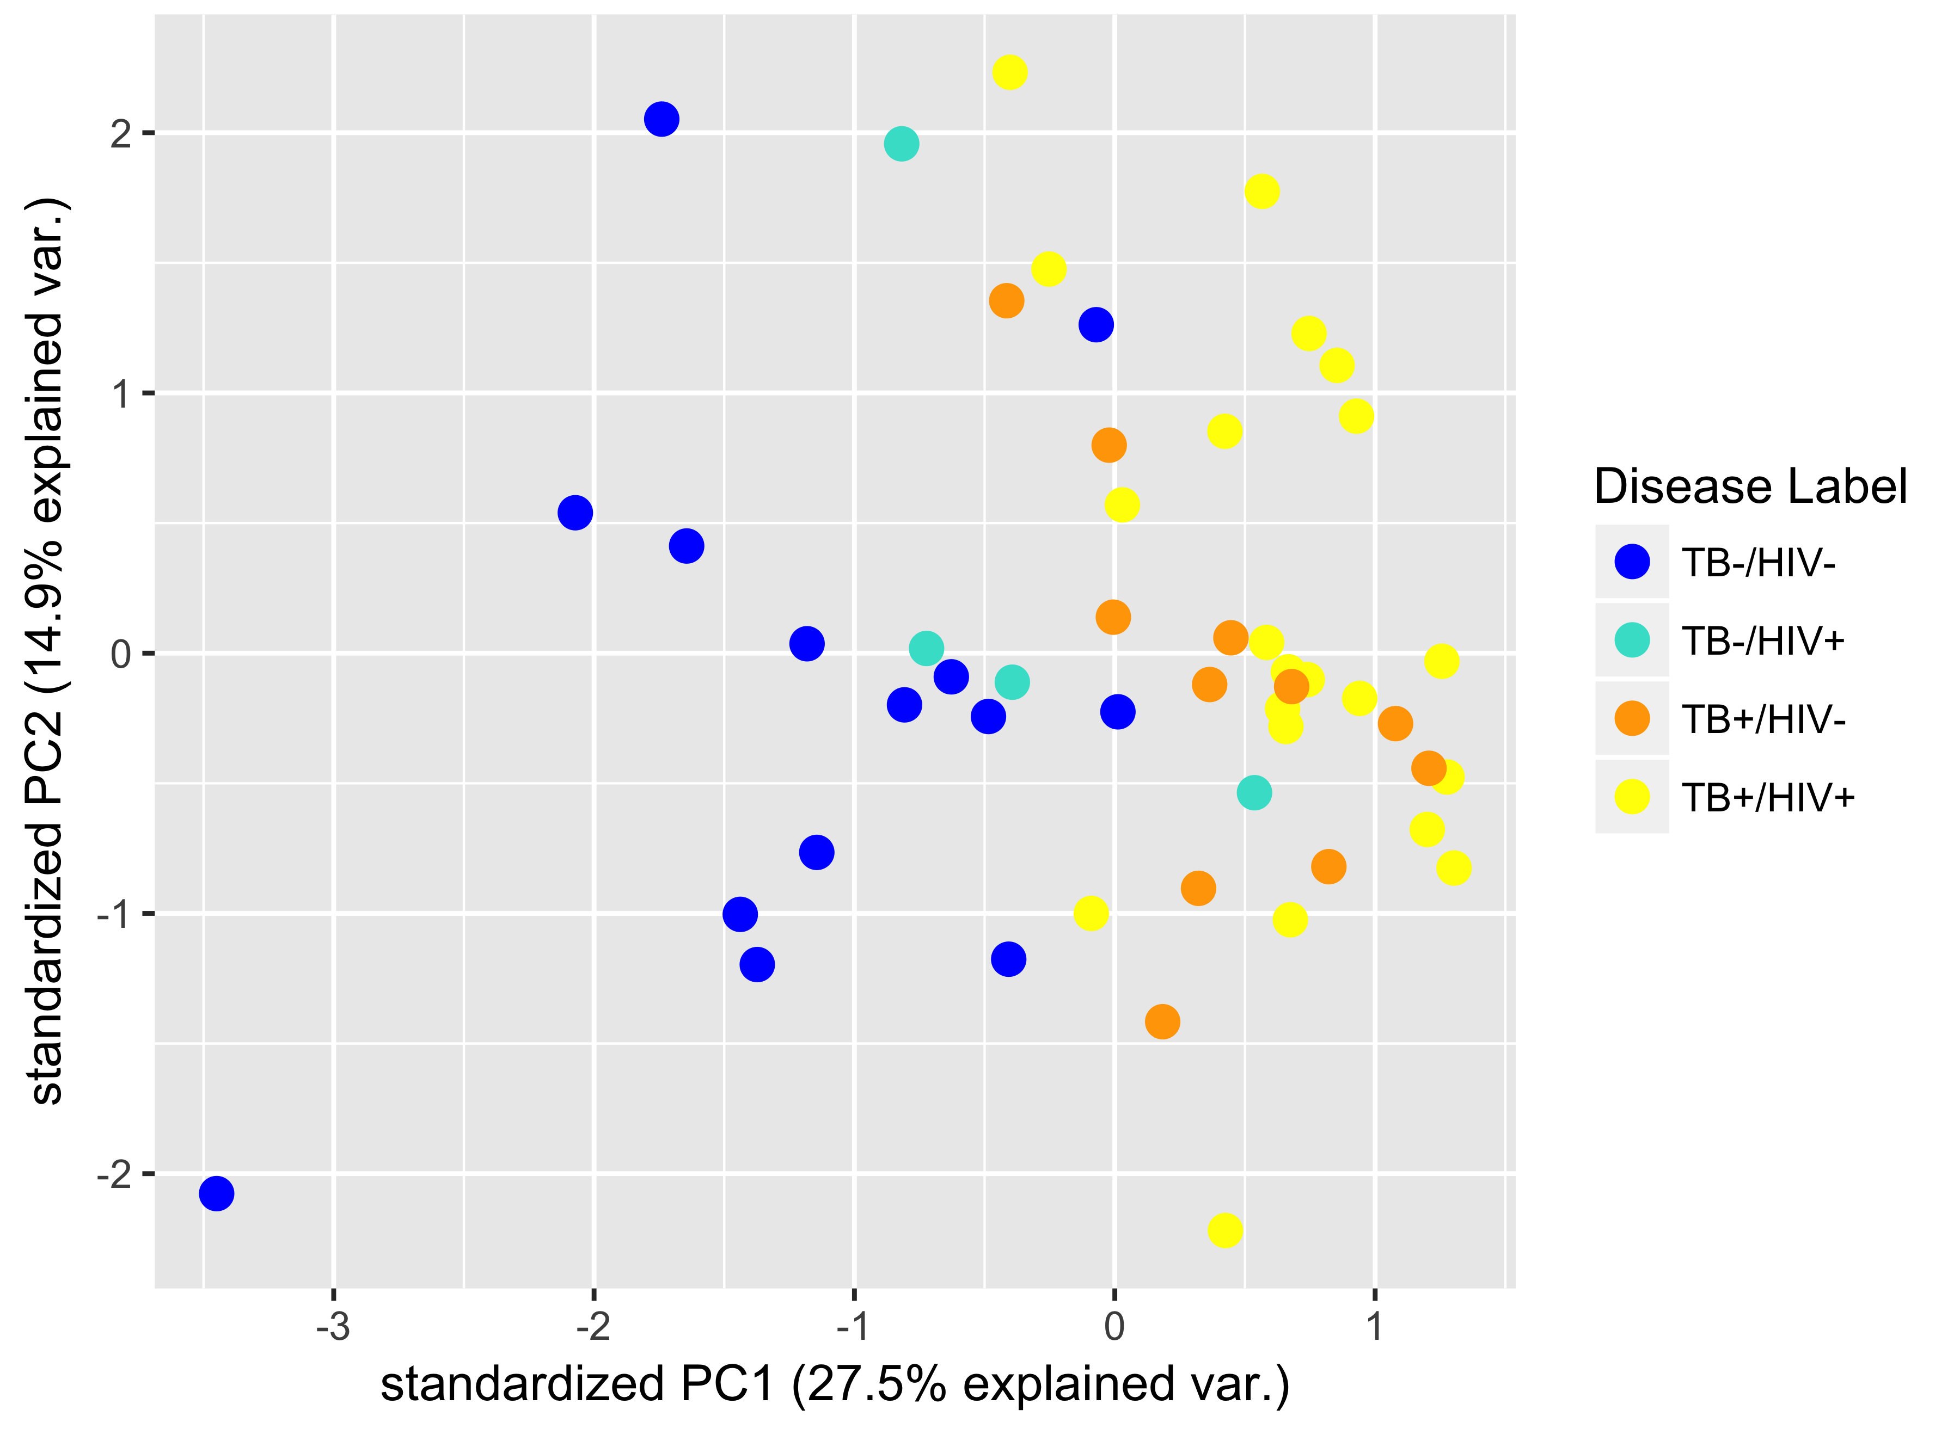
Principal Component Analysis (PCA)
Each axis is a linear combination of the selected features in the data
PCs are ordered by “explained variance”
Highly reproducible
Highly interpretable
Beccaria & Bobak, et al, JBR, 2018

Slide 9
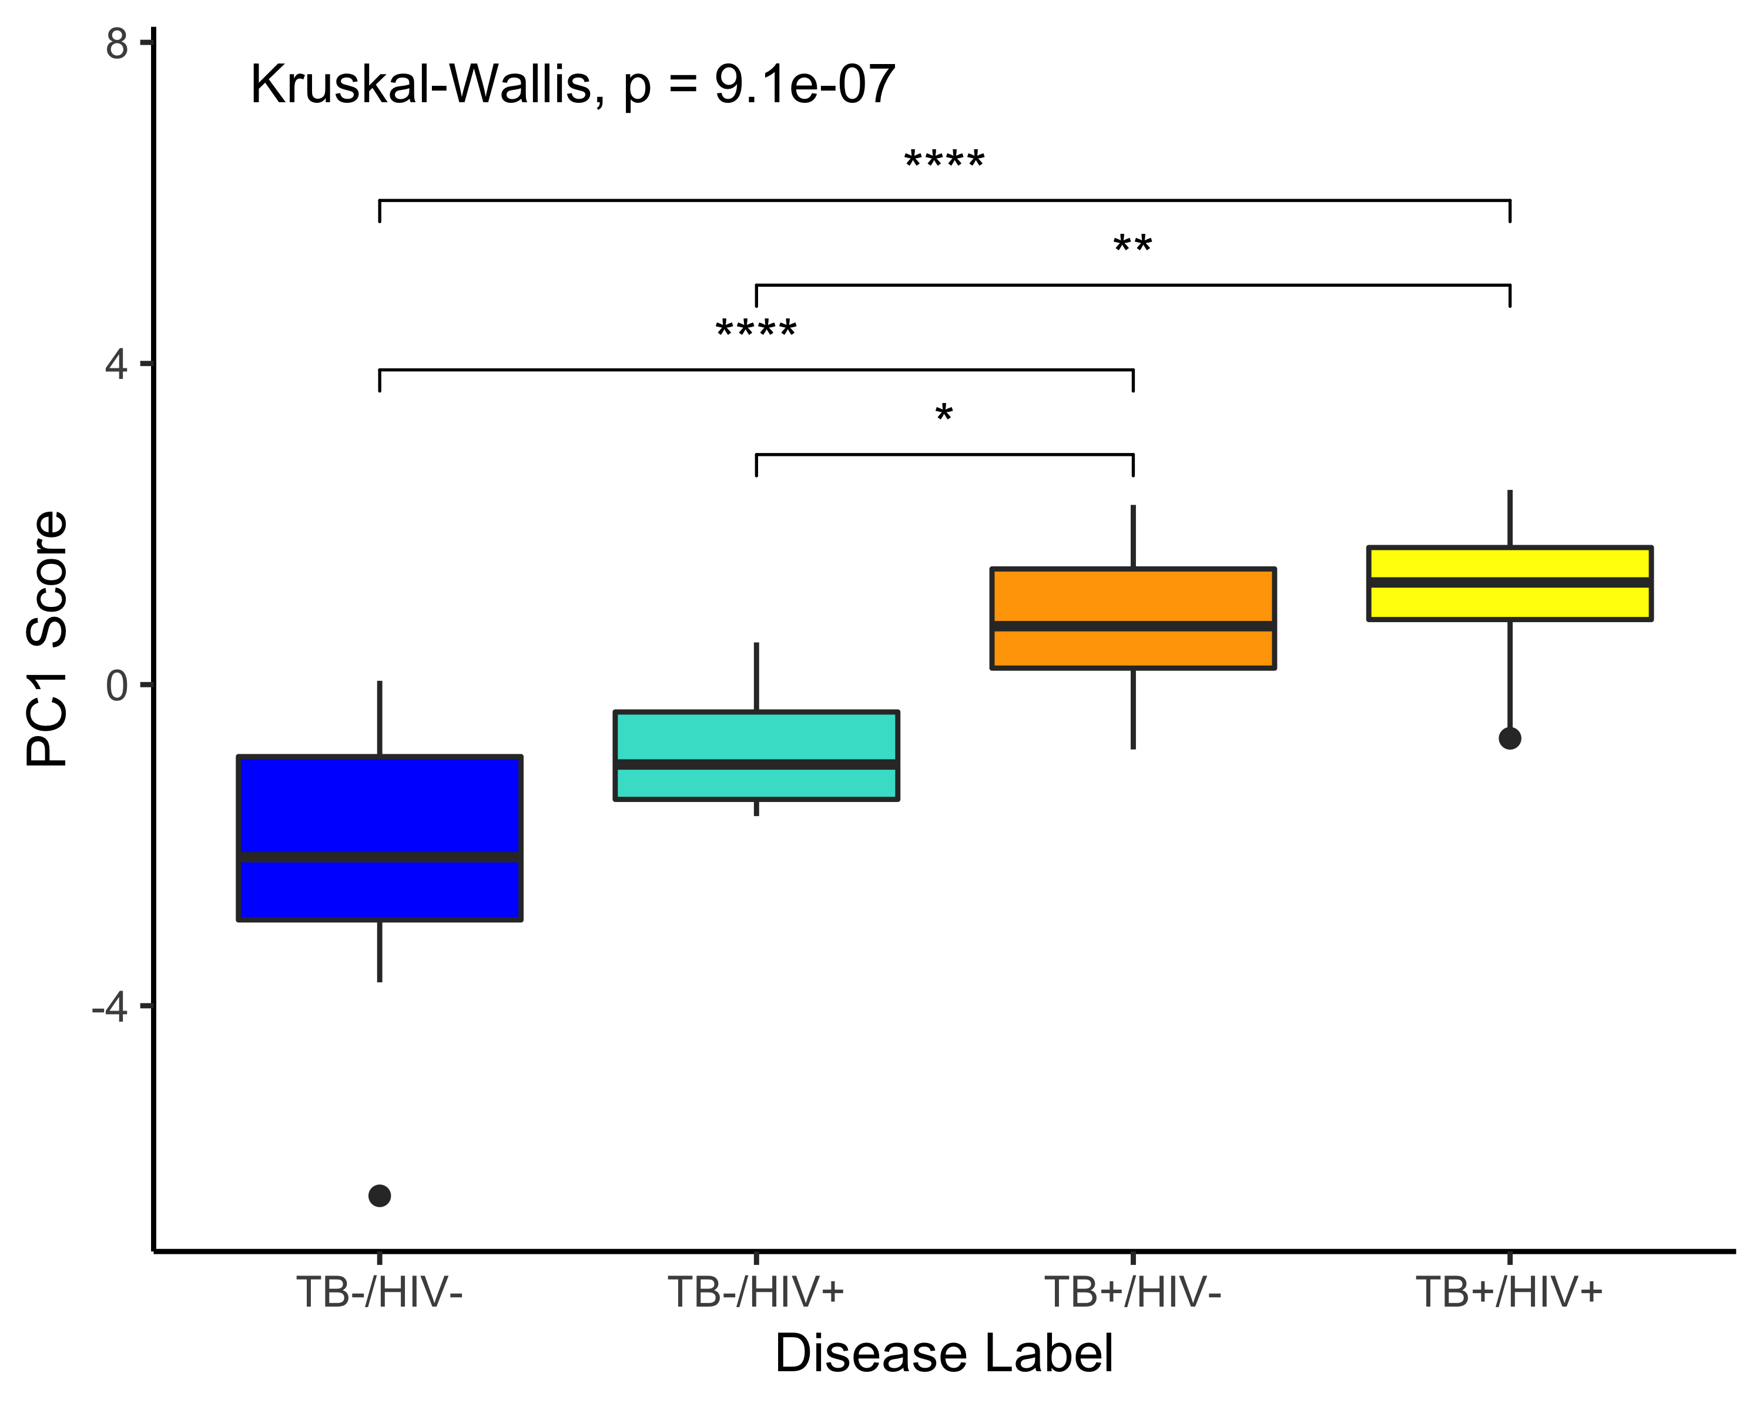
Principal Component Analysis (PCA)
Beccaria & Bobak, et al, JBR, 2018

Slide 10
T-distributed Stochastic Neighbour Embedding
Wiredu & Bobak, et al, In Prep, 2021

Slide 11
T-distributed Stochastic Neighbour Embedding
Non-linear, non-parametric representation of the data
Adept at recovering complicated clustering across different types of ‘omics data
Less reproducible – relies on a random seed and requires parameter tuning
The space between points is relative and cannot be directly interpreted
Wiredu & Bobak, et al, In Prep, 2021

Slide 12
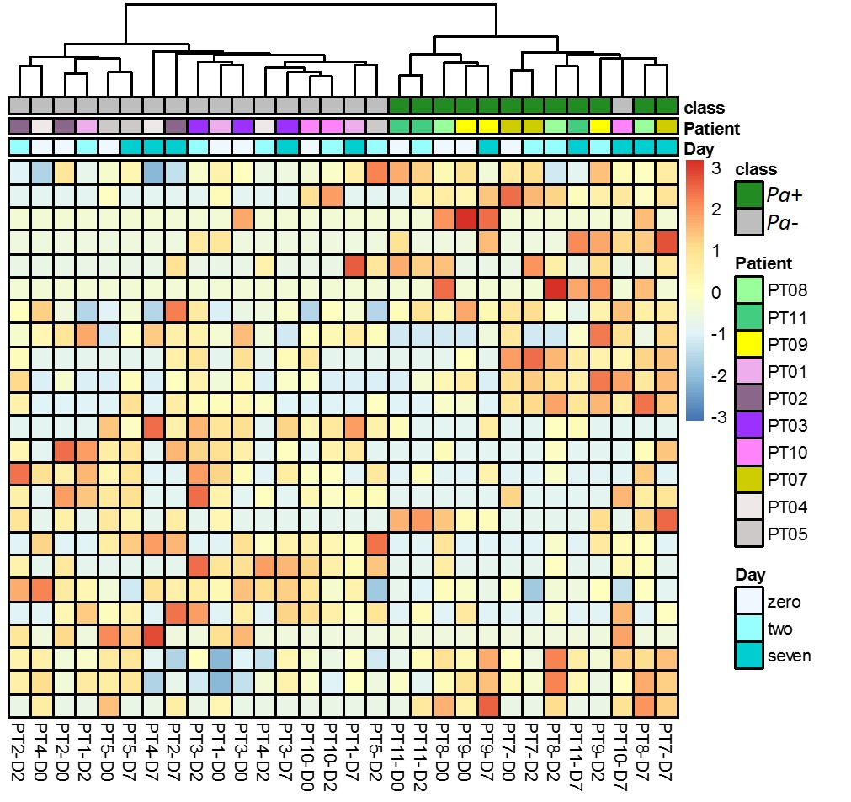
Hierarchical Clustering (Heatmaps)
Hierarchical tree (dendrogram) organizes samples according to similarity
Tip: heatmaps use Euclidean distance by default, but there are many distance metrics that are appropriate for breath data! Also try Manhattan, Correlation distances, Canberra etc.
Annotation bar allow users to quickly identify clusters of interest
Body of the heatmap shows the mean-centered normalized peak area and provides a way to visually see differences across groups.
Nasir, et al, In Prep, 2021
Notes:
Cite Mavra here.

Slide 13

Supervised Methods

Slide 14
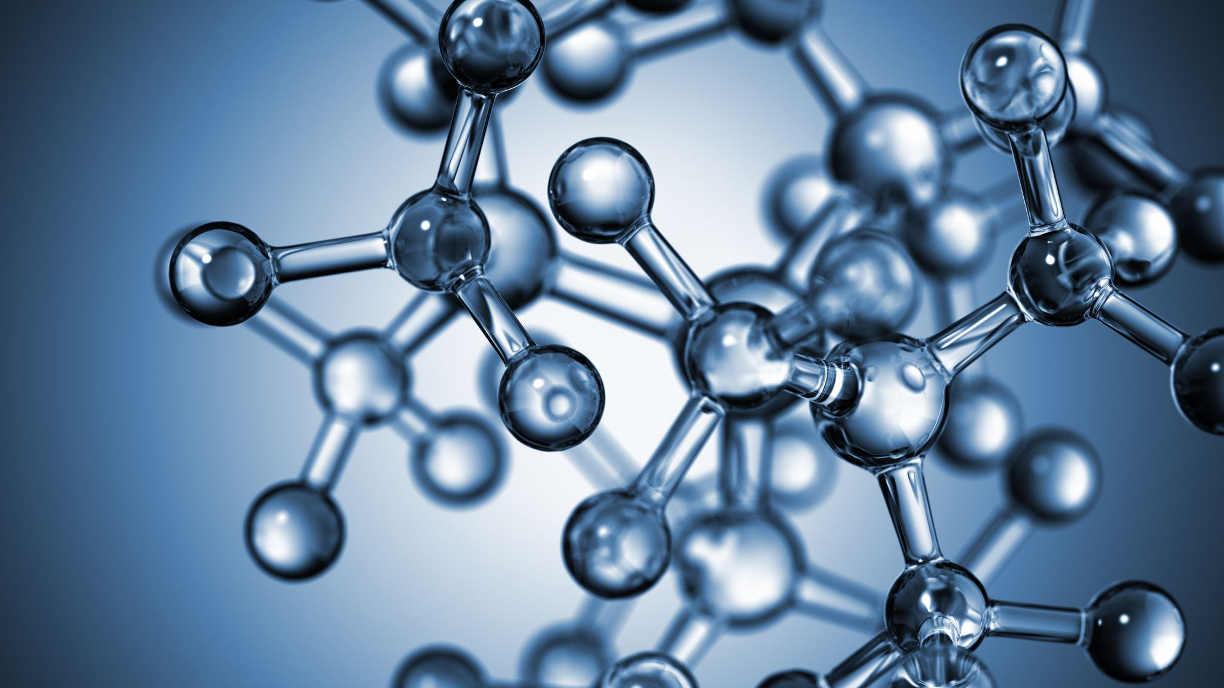
Two question types:
Which group/bin? (ie, classification task)
How much…? (ie, regression task)

Slide 15
Overview of Machine Learning Algorithms
Support Vector Machine
(SVM)
Partial Least Squares – Discriminant Analysis
(PLS-DA)
Random Forest
(RF)
Y
N
Y
Y
N
N
Y
Y
N
N
Y
Y
Y
N
N
N
Y
Y
N
N
Y
N
Y
N
Adapted from regression, is a technique which aims to define differences between groups by maximizing the covariance between samples and their groupings
Builds a series of decision trees, where each tree is built from a random subset of the data and variables are selected at each level of the tree according to which best split the data into groups
Finds a hyperplane to best divide data defined by support vectors (ie. co-ordinates) in n-dimensional space

Slide 16
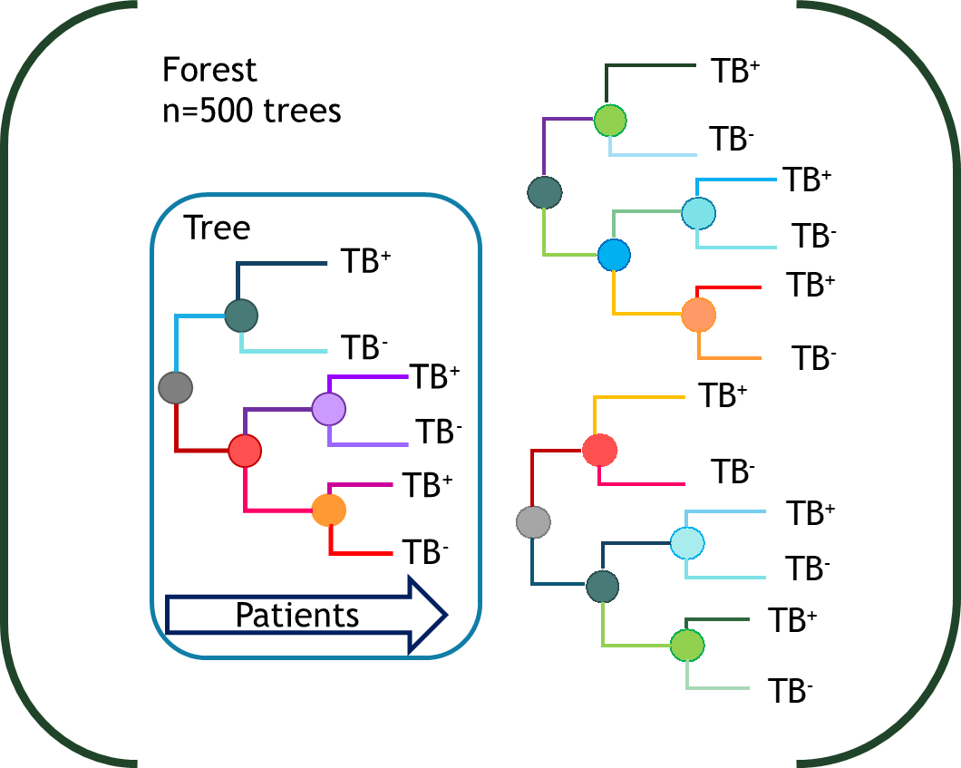

Random Forest Models
Forest
n=500 trees
Tree
TB⁺
TB⁻
TB⁺
TB⁻
TB⁺
TB⁻
Patients
Breiman Machine Learning (2011)
Notes:
Random subsample of data and random subset of candidate features used for each tree
Patients traverse every tree and votes are averaged over the forest
Random Forest models are strong classifiers in expression array data
Random forest models are good for microarray data because they are robust to problems where the number of parameters are much larger than the number of samples, they are robust to correlations between possible feaures, and they automatically generate a ranked list of feature importance.

Slide 17
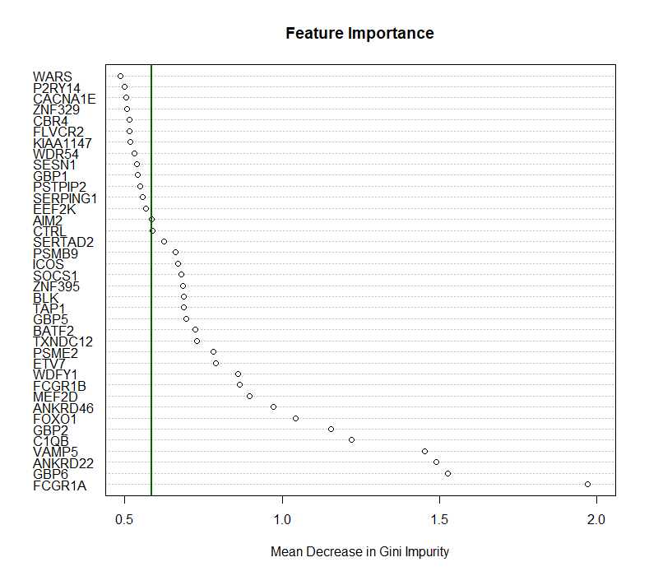
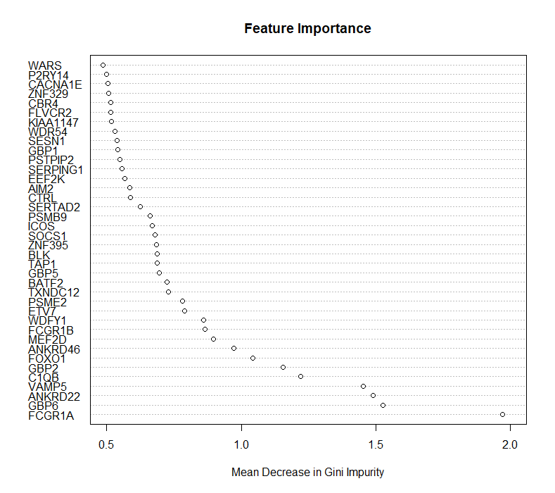
Random Forest Models
Notes:
Feature importance based on the frequency genes are chosen as ‘splitters’
Why this cutoff?

Slide 18
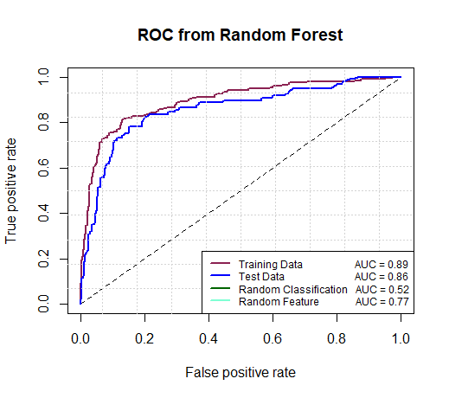
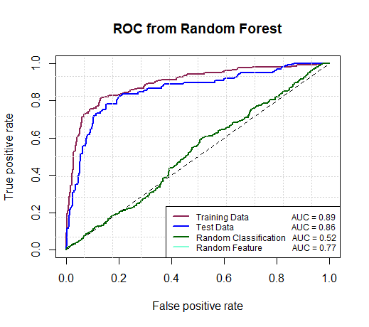
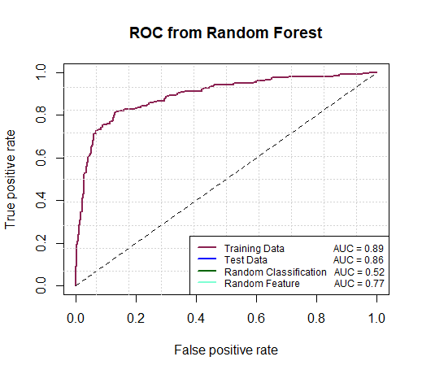
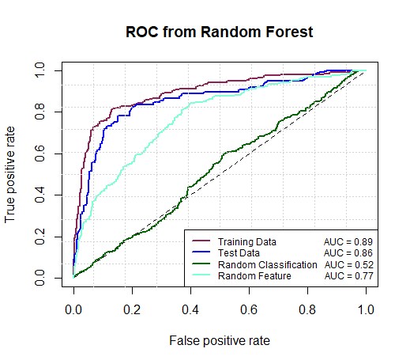
What is a reasonable expectation for model performance?
Notes:
The Out-Of-Bag (OOB) error 12
total misclassification rate of 8%.
Specificity: 94%
Sensitivity was low, at a 69%.
PPV 80%
NPV 90%
AUC 0.89 (95% CI:0.87-0.92), and 0.86 (0.81-0.90) for the test set.
Purvesh’s model performance: 0.9 for healthy controls (ours is 0.91), 0.88 for latent disease (0.94), 0.84 for other diseases (0.795).

Slide 19
What is a reasonable expectation for model performance?
Comparison Group | Bobak-Hill | Khatri
HC | 0.91 | 0.9
LTB | 0.94 | 0.88
OD | 0.80 | 0.84
Bobak, et al. Proceedings of the 11th International Joint Conference on Biomedical Engineering Systems and Technologies (2018)
Sweeney, et al. Lancet Respir. Med. (2016)
Notes:
The Out-Of-Bag (OOB) error 12
total misclassification rate of 8%.
Specificity: 94%
Sensitivity was low, at a 69%.
PPV 80%
NPV 90%
AUC 0.89 (95% CI:0.87-0.92), and 0.86 (0.81-0.90) for the test set.
Purvesh’s model performance: 0.9 for healthy controls (ours is 0.91), 0.88 for latent disease (0.94), 0.84 for other diseases (0.795).

Slide 20
Support Vector Machine
Plot each data as a point in n-dimensional space
The value of each feature serves as the co-ordinate
Support vectors are the co-ordinates of the initial observations
Find the hyper plane that best separates these co-ordinates
https://www.analyticsvidhya.com/blog/2015/10/understaing-support-vector-machine-example-code/
Notes:
Figure 1. Research strategy. e work ow was divided in four main tasks, including data collection, input data, machine learning and output data. e selected data available in the literature was organized in a matrix of labels (pathogens) and features (VOCs), and further used as the input for machine learning steps. Feature selection and classi cation algorithms were implemented using support vector machines (SVM) to determine the set of VOCs that better separates the pathogens, and build a model that predicts the pathogen based on information about the presence/absence of a set of VOCs in a sample.

Slide 21
Classic Regression Models
Simple Linear regression
Multivariate regression
Generalized Linear regression (logistic, poisson, etc.)
Regularization (elastic net, Lasso etc.)
Sparse regression, etc.
Note that some regression models are used for classification (logistic, some regularization, etc.)

Slide 22
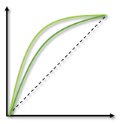
Pipeline Overview
Model Selection
Machine
Learning
Comparison and analysis
Data Simulation or Acquisition
Simulate gene expression data
Control “true” features
Add noise
Training
Test
Select Features
RF
SVM
KNN
PLS-DA
Elastic Net
Classify
Best Feature Classifiers
Validate

